Slide 1
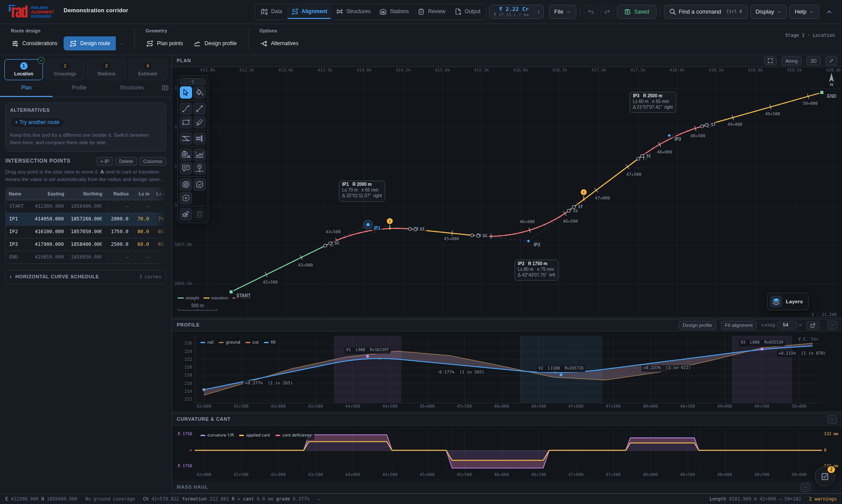
01 / START
From corridor to a reviewable railway
01
A practical 50–60 minute module for engineers and reviewers.
02
Build one traceable project: alignment, structures, estimate and deliverables.
03
Use a sample project; all illustrated values are demonstrations.
Application demonstration · toolbar positions may differ in earlier captures
Outcome: save a .rads project and explain one design decision.
RAD / PRACTICAL TRAINING / 13 October 2026
01 / 23
Notes:
Trainer: allow 2 minutes. Open the designer and a built-in sample before the session. Ask learners what evidence they need to recommend a route. This module is software training, not railway design certification. Screenshots show actual application workflows; older images can have different toolbar layouts. Use the current command labels in the written steps.
Practice: Outcome: save a .rads project and explain one design decision.
Reference: https://www.radrailway.com/docs/manual/index.html

Slide 2
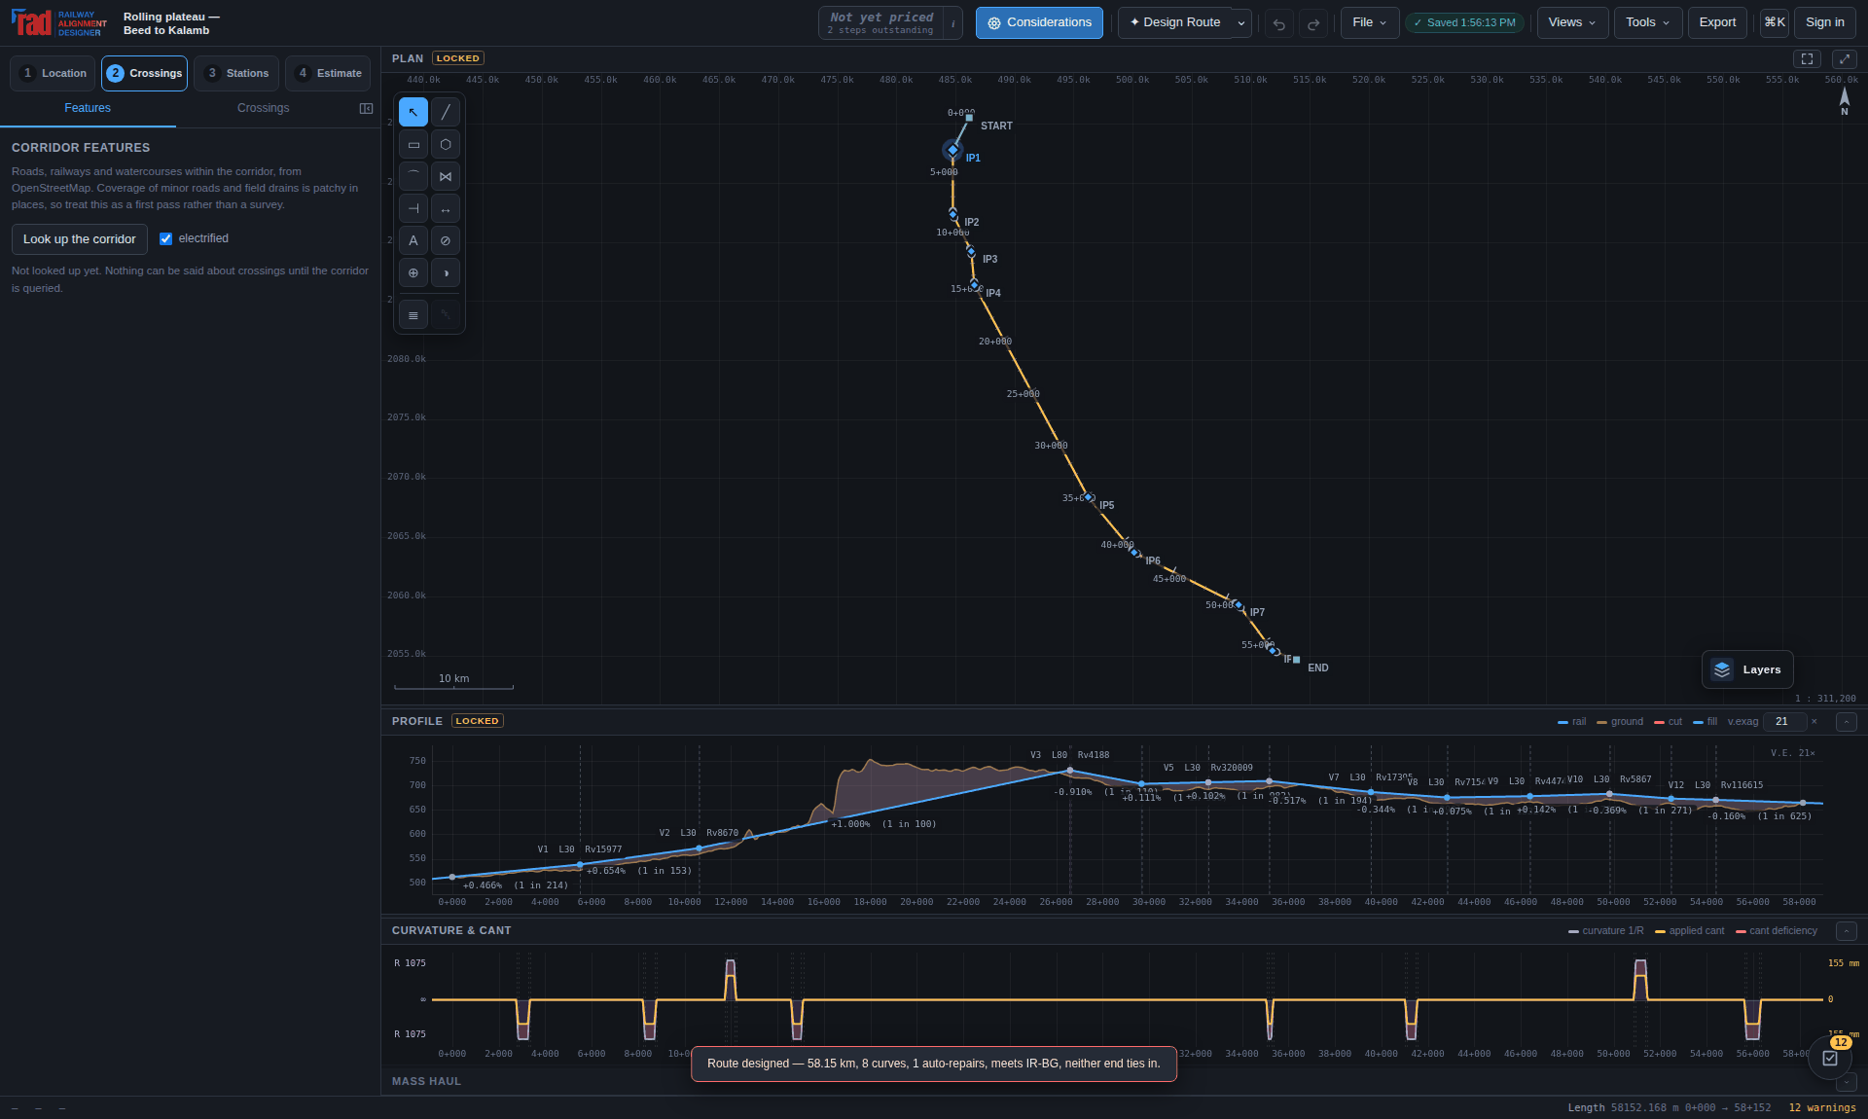
01 / START
A defensible sequence
01
Define the project basis, georeference and governing limits.
02
Compare geometry, terrain, assets and missing information.
03
Check, apply, save, then export a dated review snapshot.
Application demonstration · toolbar positions may differ in earlier captures
Discuss: a green check is evidence of which rule, at which limit?
RAD / PRACTICAL TRAINING / 13 October 2026
02 / 23
Notes:
Allow 2 minutes. Walk through the stage prerequisites. A compliant calculation is not an approved railway scheme. A missing input cannot be treated as a zero. Distinguish completed software stages from independently approved surveys, clearances and financial decisions.
Practice: Discuss: a green check is evidence of which rule, at which limit?
Reference: https://www.radrailway.com/docs/manual/index.html

Slide 3
02 / WORKSPACE
Navigate without losing your place
01
Use the grouped toolbar to open the relevant design workspace.
02
Plan locates the route; Profile explains levels and gradients.
03
The bottom-left activity indicator reports ongoing operations.
Application demonstration · toolbar positions may differ in earlier captures
Locate Plan, Profile, Output and Save in the current workspace.
RAD / PRACTICAL TRAINING / 13 October 2026
03 / 23
Notes:
Allow 2 minutes. Point out the grouped commands in the screenshot, then demonstrate their current positions in the running app. Activity may be indeterminate when an upstream service cannot report a percentage. Do not start the same long operation repeatedly while a request is progressing.
Practice: Locate Plan, Profile, Output and Save in the current workspace.
Reference: https://www.radrailway.com/docs/manual/index.html

Slide 4
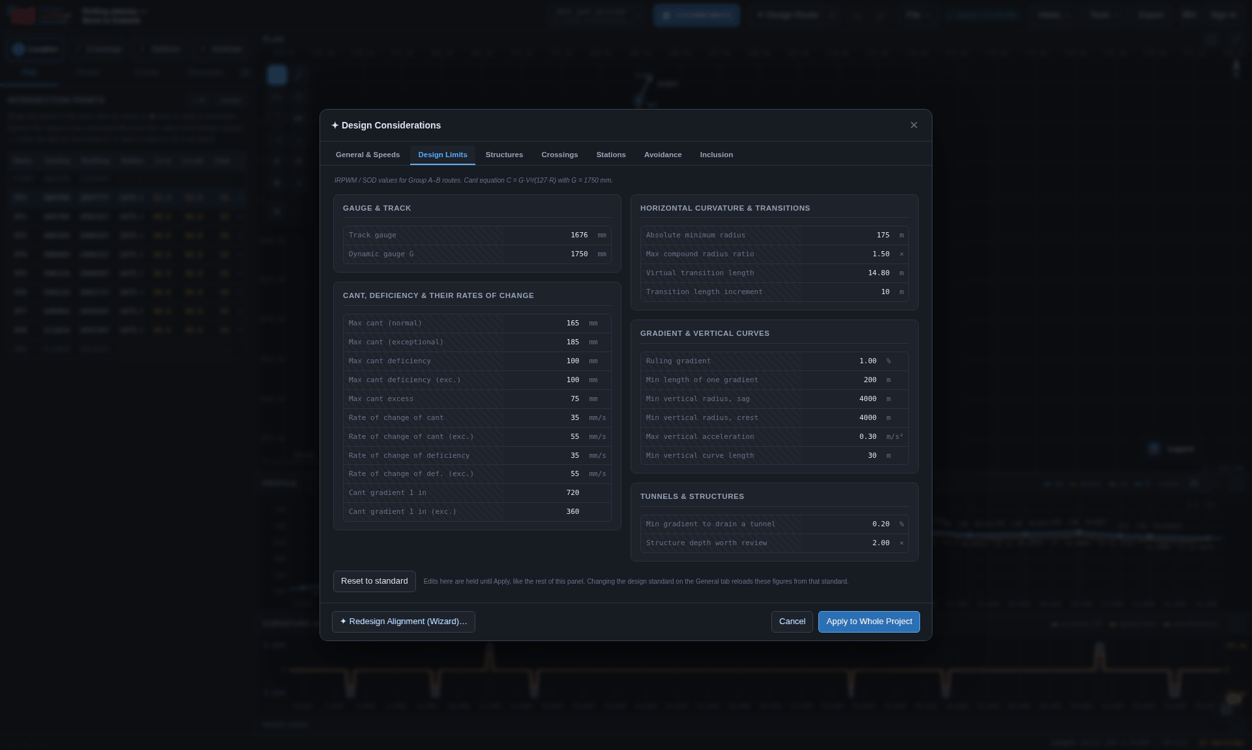
03 / GEOMETRY
Establish the design basis
01
Choose the standard, gauge, speed and ruling gradient deliberately.
02
Verify the project coordinate system and elevation datum.
03
Record overrides and the governing circular or specification.
Application demonstration · toolbar positions may differ in earlier captures
Write down your chosen speed, gauge and ruling gradient.
RAD / PRACTICAL TRAINING / 13 October 2026
04 / 23
Notes:
Allow 2 minutes. Open the design limits and show a normal and exceptional limit. Presets are editable starting points. Note that changing a preset may affect derived checks. Confirm units: radius and chainage in metres, speed in km/h, cant in mm, gradient in percent.
Practice: Write down your chosen speed, gauge and ruling gradient.
Reference: https://www.radrailway.com/docs/manual/index.html

Slide 5
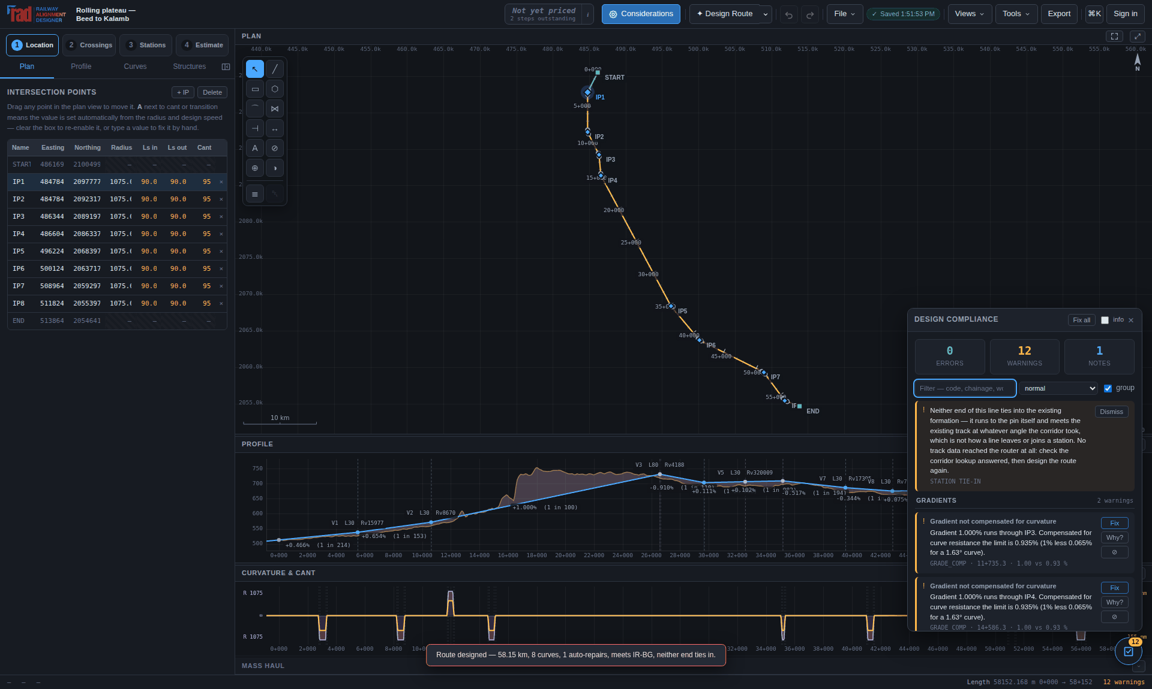
03 / GEOMETRY
Route the corridor and preserve alternatives
01
Supply endpoints, obligatory points and known exclusions.
02
Inspect terrain coverage and station tie-ins before accepting a route.
03
Retain alternative routes to compare geometry, structures and cost.
Application demonstration · toolbar positions may differ in earlier captures
Identify one constraint that could change the preferred route.
RAD / PRACTICAL TRAINING / 13 October 2026
05 / 23
Notes:
Allow 3 minutes. Demonstrate the route workflow with an existing sample so the lesson does not depend on live terrain queries. The older screenshot illustrates a route result and is not evidence that a live service is currently available. Explain why a route can need more development length to achieve the ruling gradient.
Practice: Identify one constraint that could change the preferred route.
Reference: https://www.radrailway.com/docs/manual/index.html

Slide 6
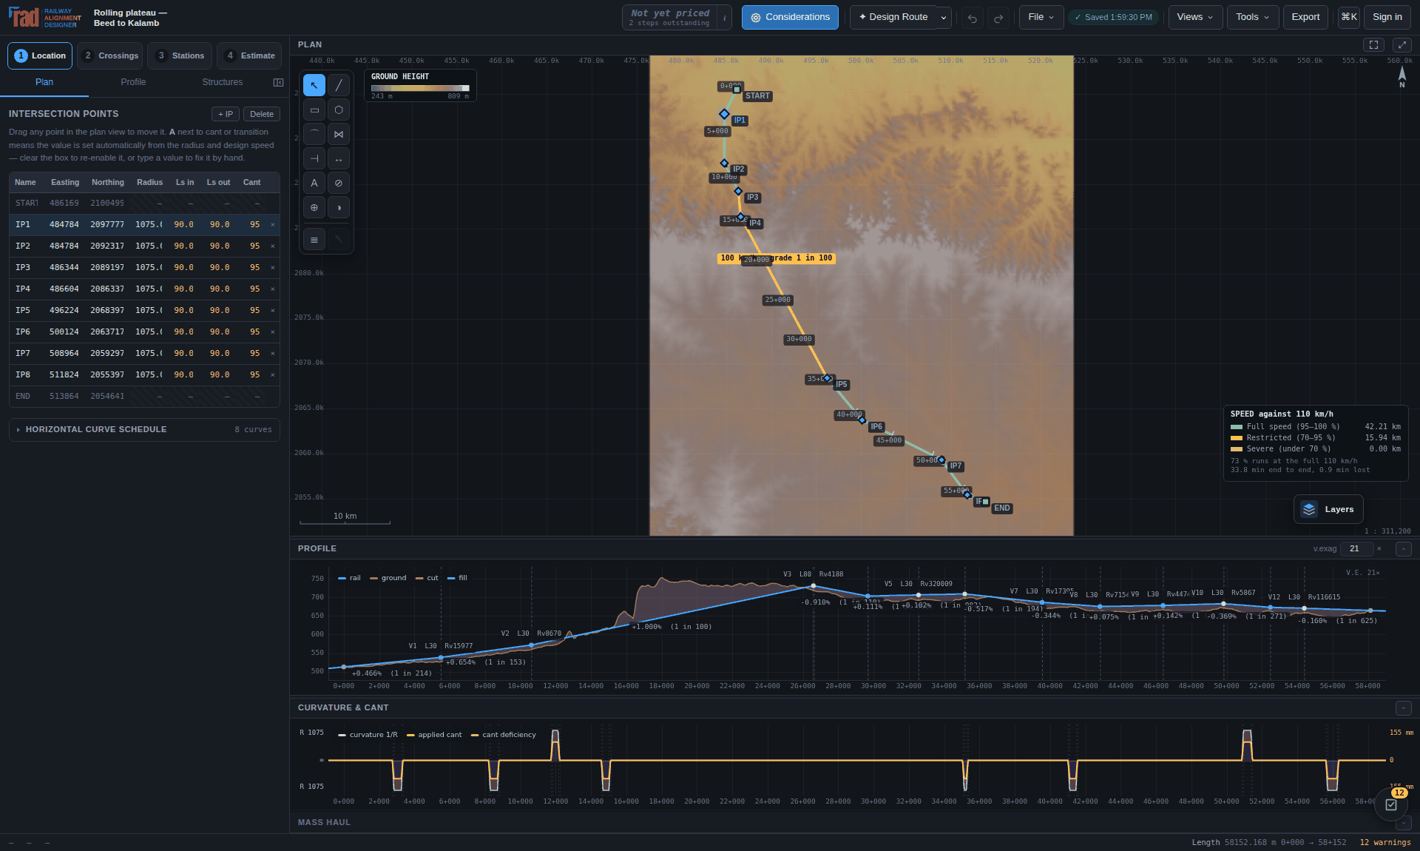
03 / GEOMETRY
Read a plan as engineering evidence
01
Chainage locates an event along the computed centreline.
02
Radius, transitions and cant jointly determine speed checks.
03
Inspect difficult reaches, interfaces and station approaches.
Application demonstration · toolbar positions may differ in earlier captures
Explain why a curve can pass radius yet fail another check.
RAD / PRACTICAL TRAINING / 13 October 2026
06 / 23
Notes:
Allow 2 minutes. Ask learners to identify a curve and its transition points. Do not equate the design speed with a permitted operating speed. Cant excess on slower traffic and transition comfort criteria can govern even when the radius seems adequate.
Practice: Explain why a curve can pass radius yet fail another check.
Reference: https://www.radrailway.com/docs/manual/index.html

Slide 7
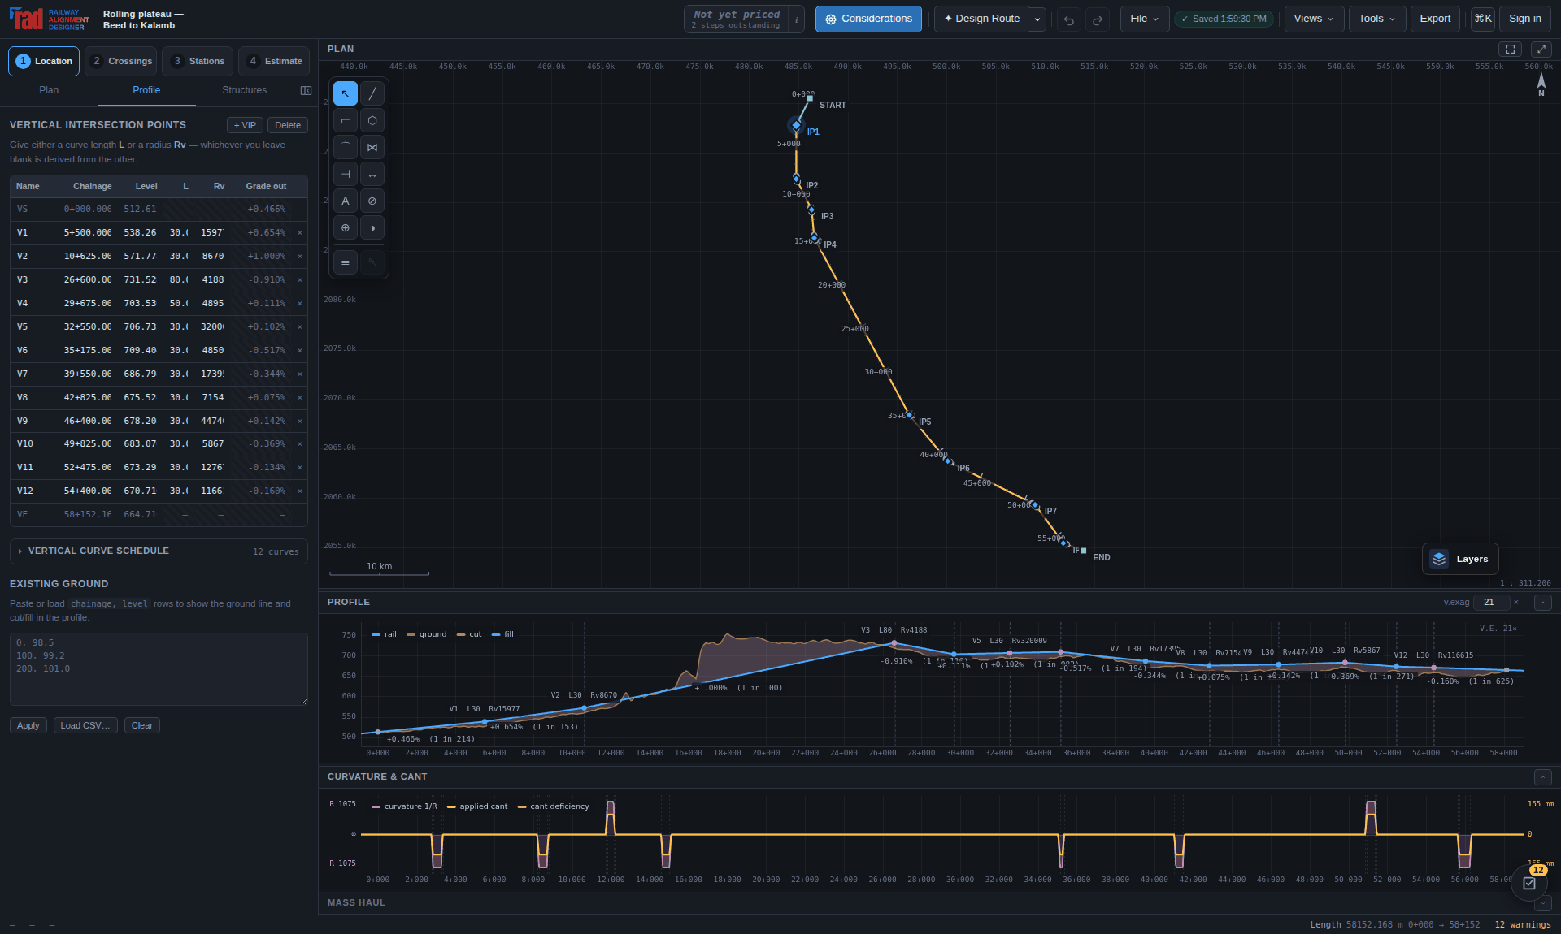
03 / GEOMETRY
Read the profile with the ground
01
Compare rail and ground levels using the correct datum.
02
Review grades, vertical curves and cut/fill at critical chainages.
03
Terrain gaps remain unknown; verify them before quantities are relied on.
Application demonstration · toolbar positions may differ in earlier captures
Find one reach where a profile adjustment changes the works.
RAD / PRACTICAL TRAINING / 13 October 2026
07 / 23
Notes:
Allow 3 minutes. Read a summit or sag, explain VIP and BVC/EVC terminology, and identify the ground profile. A straight line over a missing terrain interval does not create surveyed ground. Check station grades and structure clearances after vertical changes.
Practice: Find one reach where a profile adjustment changes the works.
Reference: https://www.radrailway.com/docs/manual/index.html

Slide 8
03 / GEOMETRY
Notations that prevent a costly mistake
01
CH 12+530 = chainage 12,530 m from the adopted chainage datum.
02
R = horizontal radius; Ls = transition length; C = applied cant.
03
Grade 1.00% = 1 in 100; 1 in 200 = 0.50%.
Explanatory notation diagram · schematic, not to scale
Check: what is 7+250 in metres, and what is 1 in 80 as a percent?
RAD / PRACTICAL TRAINING / 13 October 2026
08 / 23
Notes:
Allow 2 minutes. Answers: 7,250 m and 1.25%. Distinguish track gauge from dynamic gauge G in the equilibrium cant equation. A diagram is schematic unless it states a scale. In railway documents always give the unit with a quantity. The project may begin at a nonzero chainage; chainage is not automatically distance from its first point.
Practice: Check: what is 7+250 in metres, and what is 1 in 80 as a percent?
Reference: https://www.radrailway.com/docs/manual/index.html

Slide 9
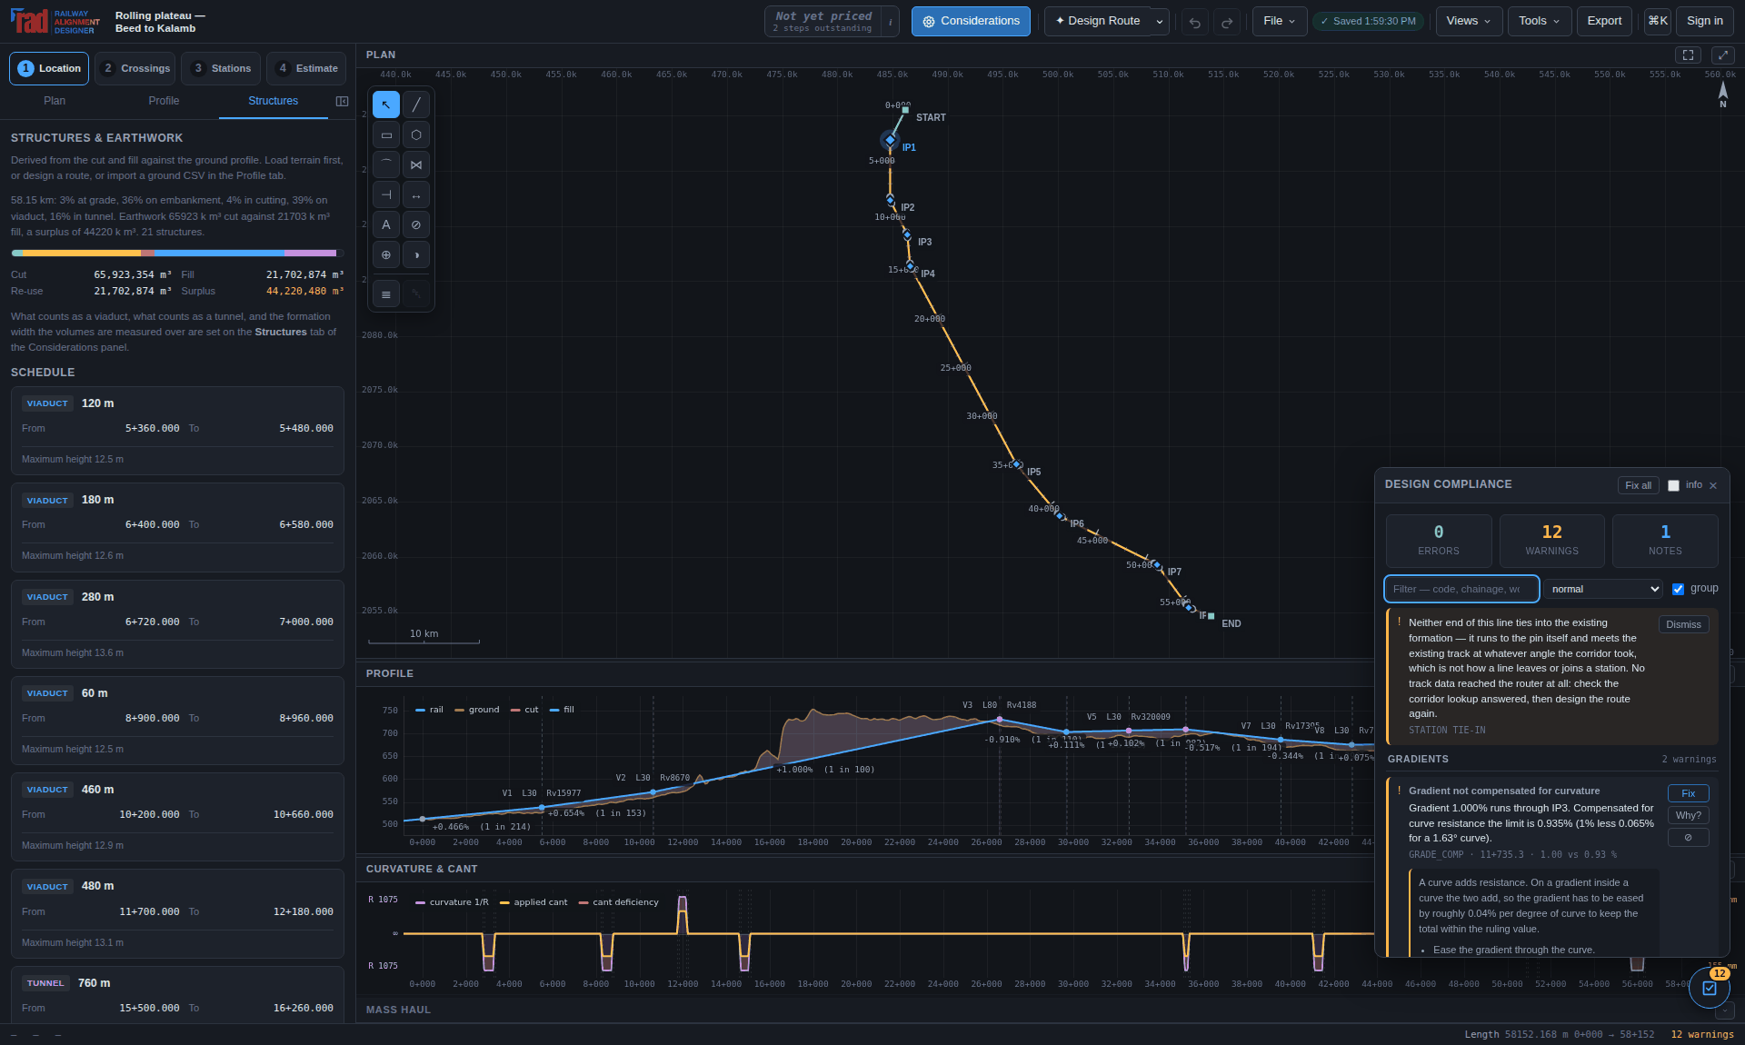
04 / ASSURANCE
Turn a finding into a reviewed decision
01
Read the measured value, limit, severity and rule reference.
02
Use Why? to understand the cause and possible remedies.
03
Recalculate after a repair and record intentional overrides.
Application demonstration · toolbar positions may differ in earlier captures
Choose one finding and describe a repair plus its side effects.
RAD / PRACTICAL TRAINING / 13 October 2026
09 / 23
Notes:
Allow 3 minutes. A repair that resolves one rule can worsen another, so rerun the complete checks. Strict mode and project overrides can change the presentation of severity. Review the override register before using a clean report as evidence.
Practice: Choose one finding and describe a repair plus its side effects.
Reference: https://www.radrailway.com/docs/manual/index.html

Slide 10
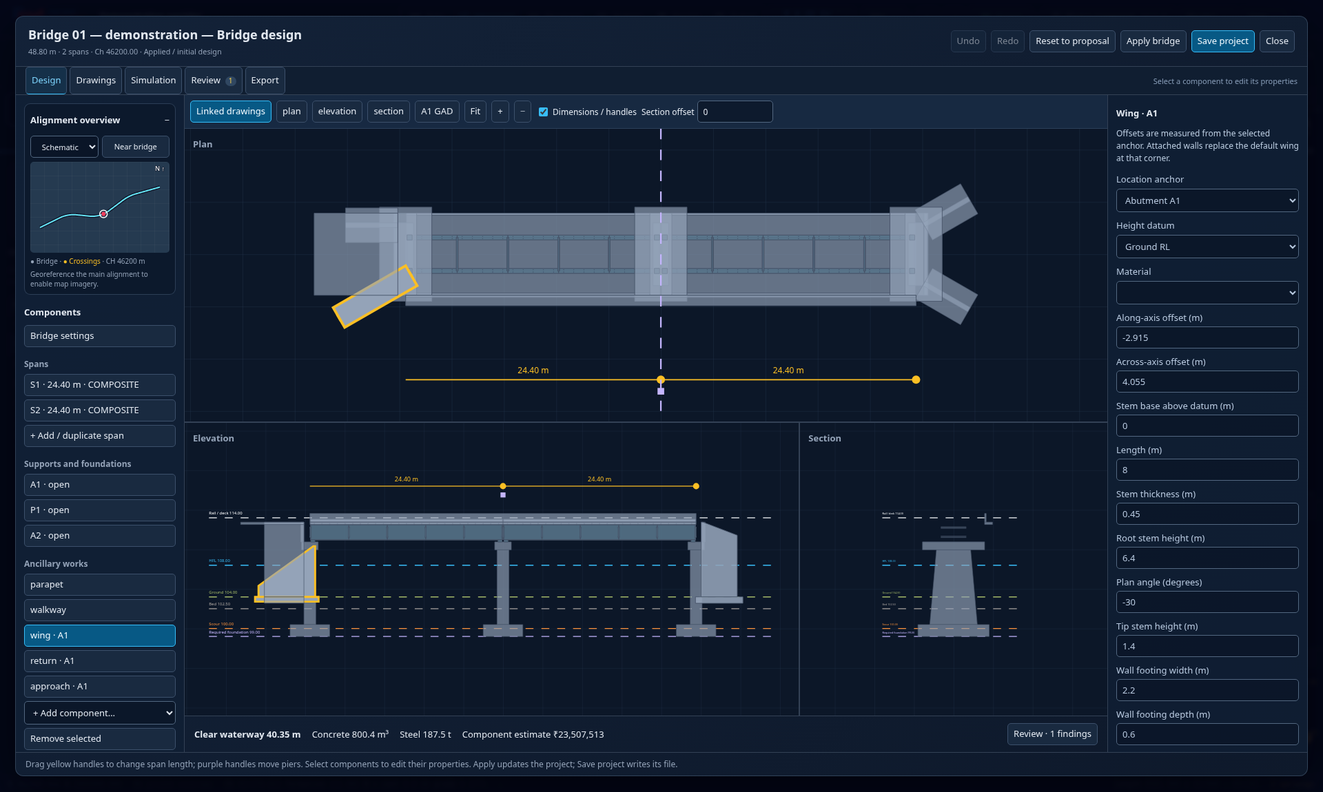
04 / ASSURANCE
Crossings and bridges: retain the unknowns
01
Review crossing identity, chainage, skew and source confidence.
02
Edit spans, supports, foundations and approach walls in Workspace.
03
Check clearance and unresolved arrangement findings explicitly.
Application demonstration · toolbar positions may differ in earlier captures
Name one dimension that requires survey or structural design.
RAD / PRACTICAL TRAINING / 13 October 2026
10 / 23
Notes:
Allow 3 minutes. A generated bridge arrangement is preliminary geometry. Demonstrate how a changed wall or span appears in linked views. Do not describe mapped obstacle levels or proposed support sizes as approved design inputs.
Practice: Name one dimension that requires survey or structural design.
Reference: https://www.radrailway.com/docs/manual/index.html

Slide 11
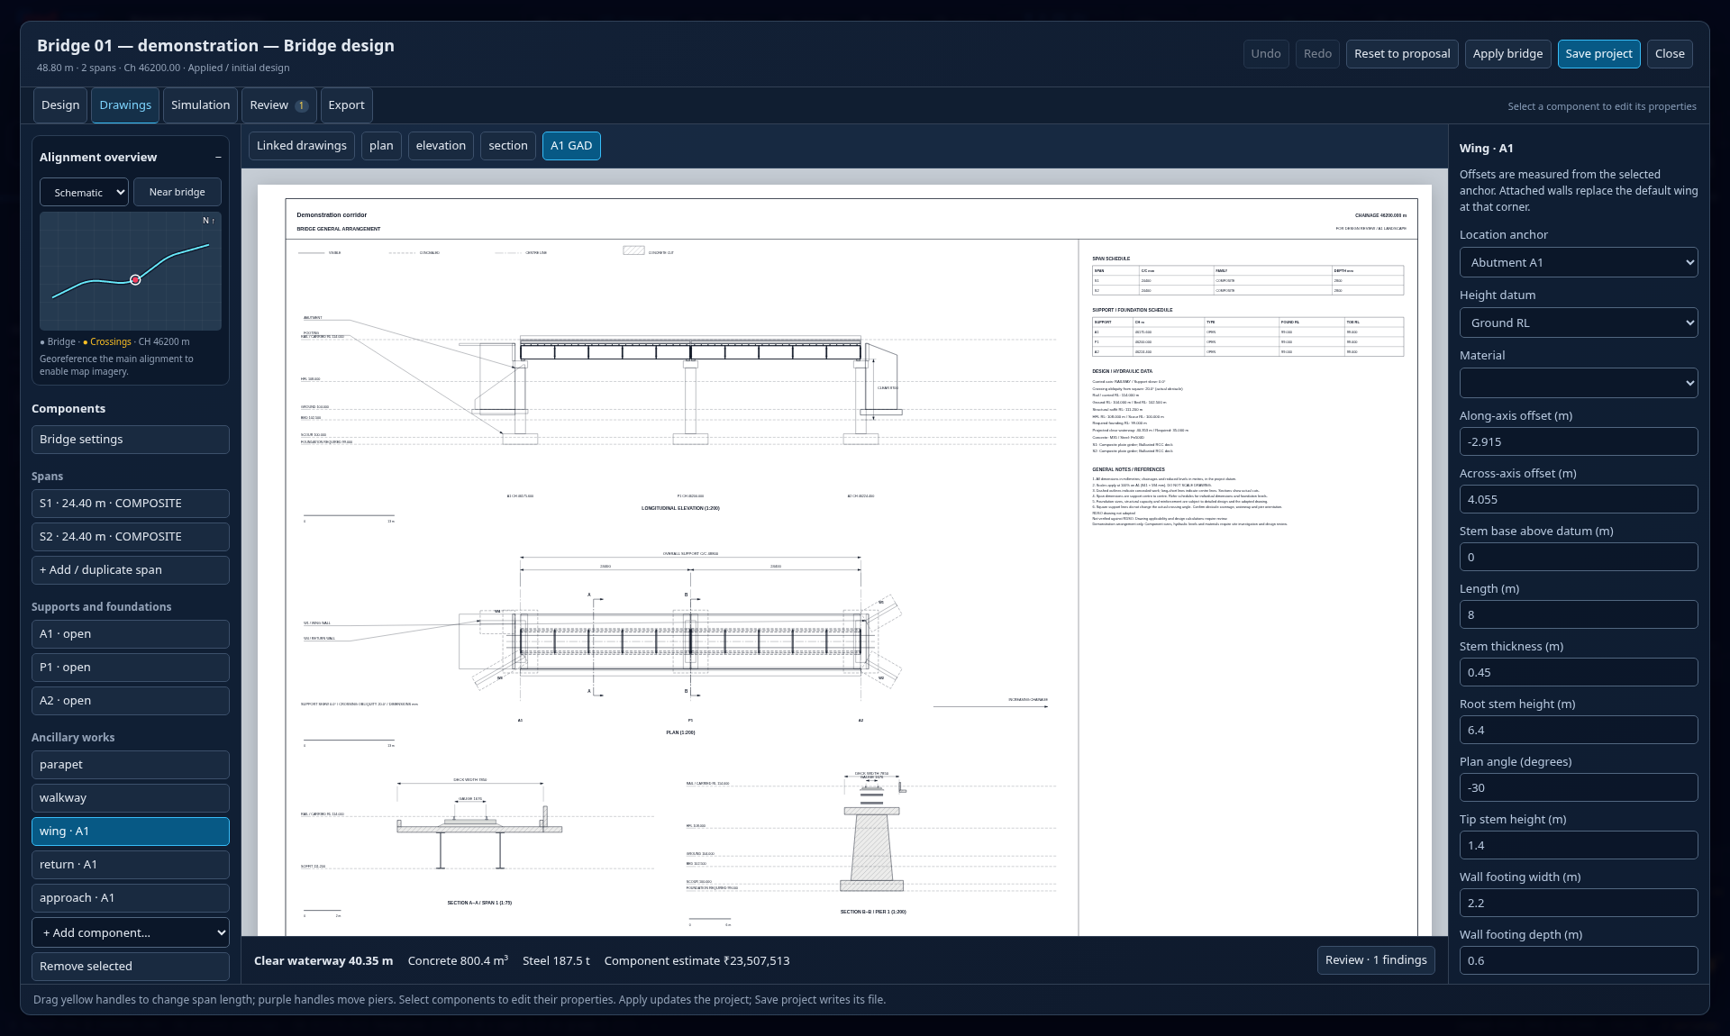
04 / ASSURANCE
Read the GAD at the stated scale
01
Review plan, elevation, sections, schedules and title information together.
02
Check the level and dimension references before sharing sheets.
03
Print A1 drawings at actual size when a scale is required.
Application demonstration · toolbar positions may differ in earlier captures
Explain why fitting a drawing to A4 changes its plotted scale.
RAD / PRACTICAL TRAINING / 13 October 2026
11 / 23
Notes:
Allow 2 minutes. The screenshot shows the visible portion of an A1 preview, not a complete structural calculation. Drawing dimensions remain numerical facts; a scaled measurement is only valid at the specified print size. Export a reviewed sheet for the class to inspect.
Practice: Explain why fitting a drawing to A4 changes its plotted scale.
Reference: https://www.radrailway.com/docs/manual/index.html

Slide 12
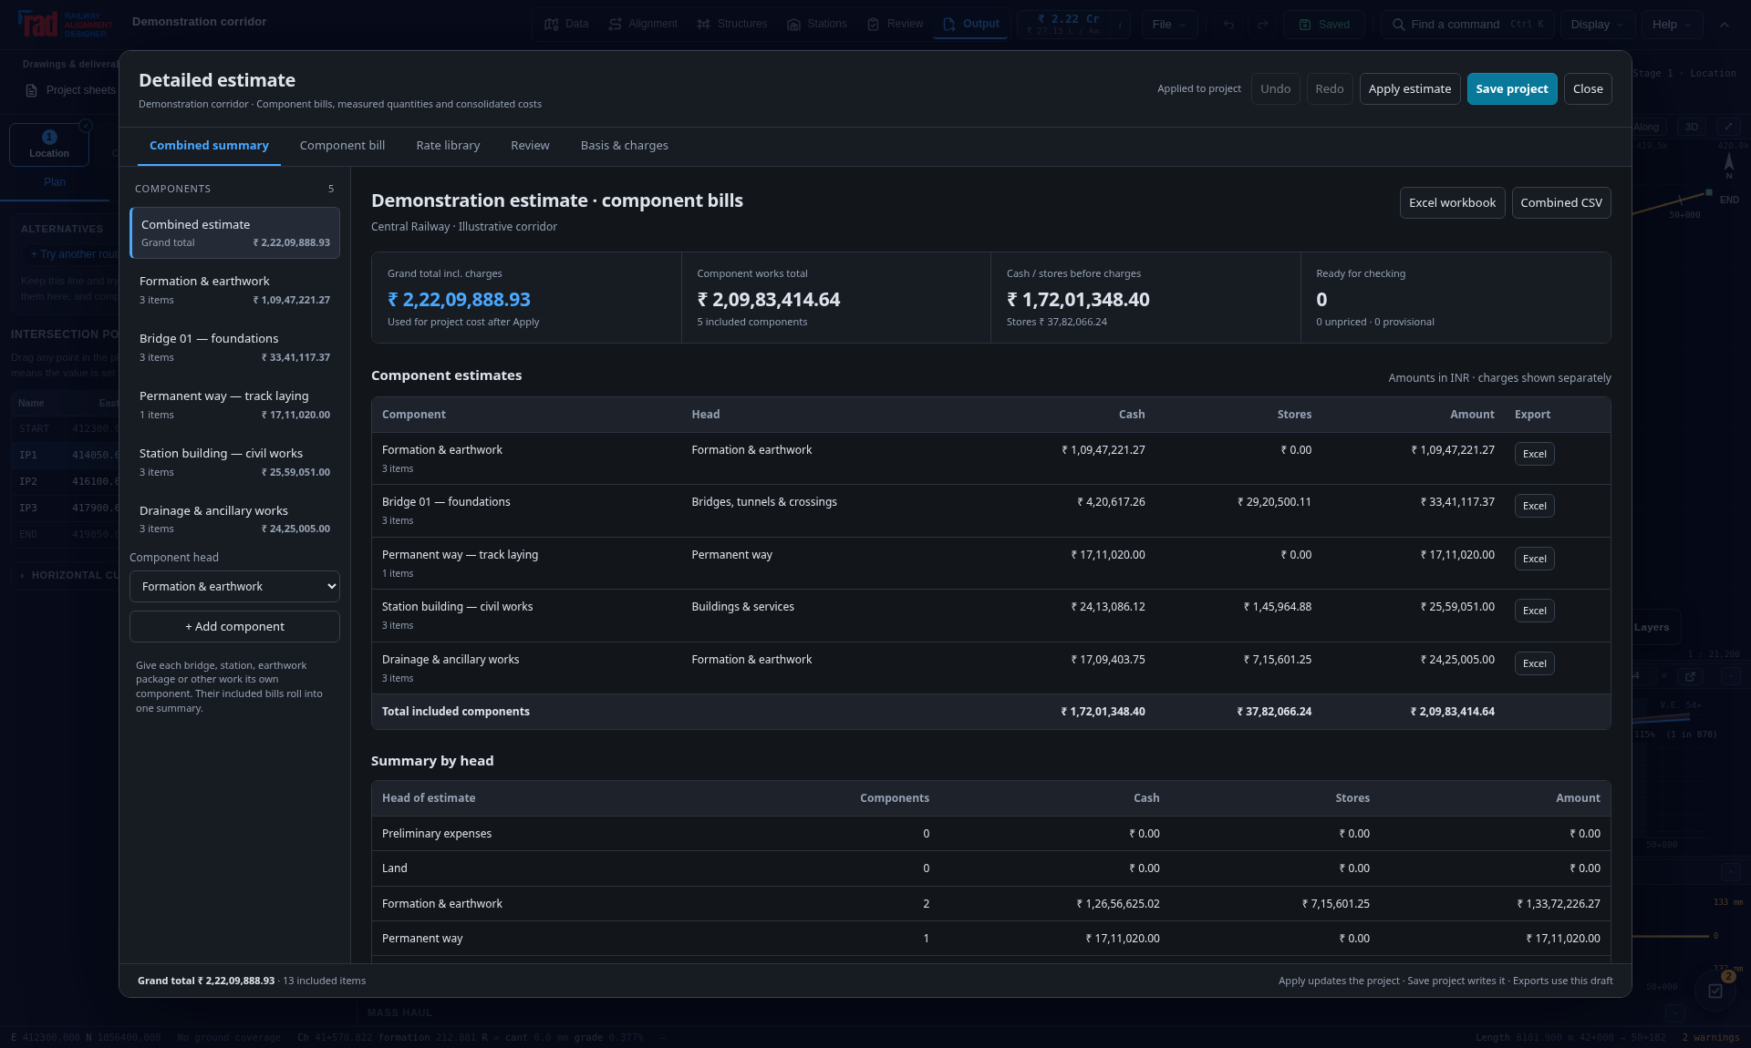
05 / COST
Build a traceable detailed estimate
01
Use named components and measurable bill items.
02
Retain the source schedule, item code, billing unit and adopted rate.
03
Keep unpriced and provisional items visible in the abstract.
Application demonstration · toolbar positions may differ in earlier captures
Find one cost item and trace its quantity back to a measurement.
RAD / PRACTICAL TRAINING / 13 October 2026
12 / 23
Notes:
Allow 3 minutes. Explain a component, a plan head and a bill item using the visible editor. The imported or detailed bill is a saved snapshot; changing the alignment does not automatically certify or reconcile every measured quantity. Review charges and GST separately.
Practice: Find one cost item and trace its quantity back to a measurement.
Reference: https://www.radrailway.com/docs/manual/index.html

Slide 13
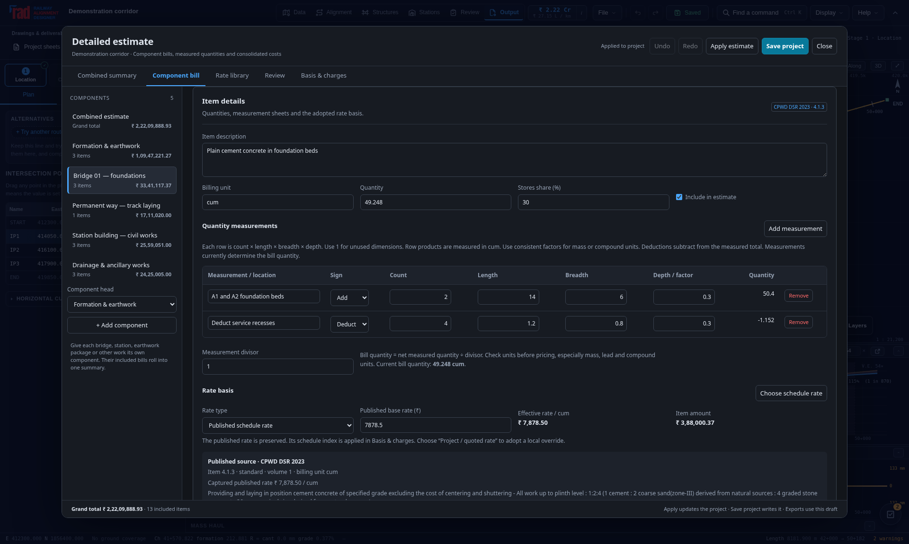
05 / COST
Measurement, rate and saved snapshot
01
Confirm dimensions, multipliers, deductions and billing-unit conversion.
02
Review missing rates and ambiguous schedule units before applying.
03
Apply updates the project; Save project persists the adopted changes.
Application demonstration · toolbar positions may differ in earlier captures
Demonstrate the difference between an editor draft and the saved project.
RAD / PRACTICAL TRAINING / 13 October 2026
13 / 23
Notes:
Allow 2 minutes. Ask learners to calculate one simple row independently. A rate source is not a locally approved price. Explain that exporting the editor draft can differ from a report built from the applied project snapshot. Check the save destination and date.
Practice: Demonstrate the difference between an editor draft and the saved project.
Reference: https://www.radrailway.com/docs/manual/index.html

Slide 14
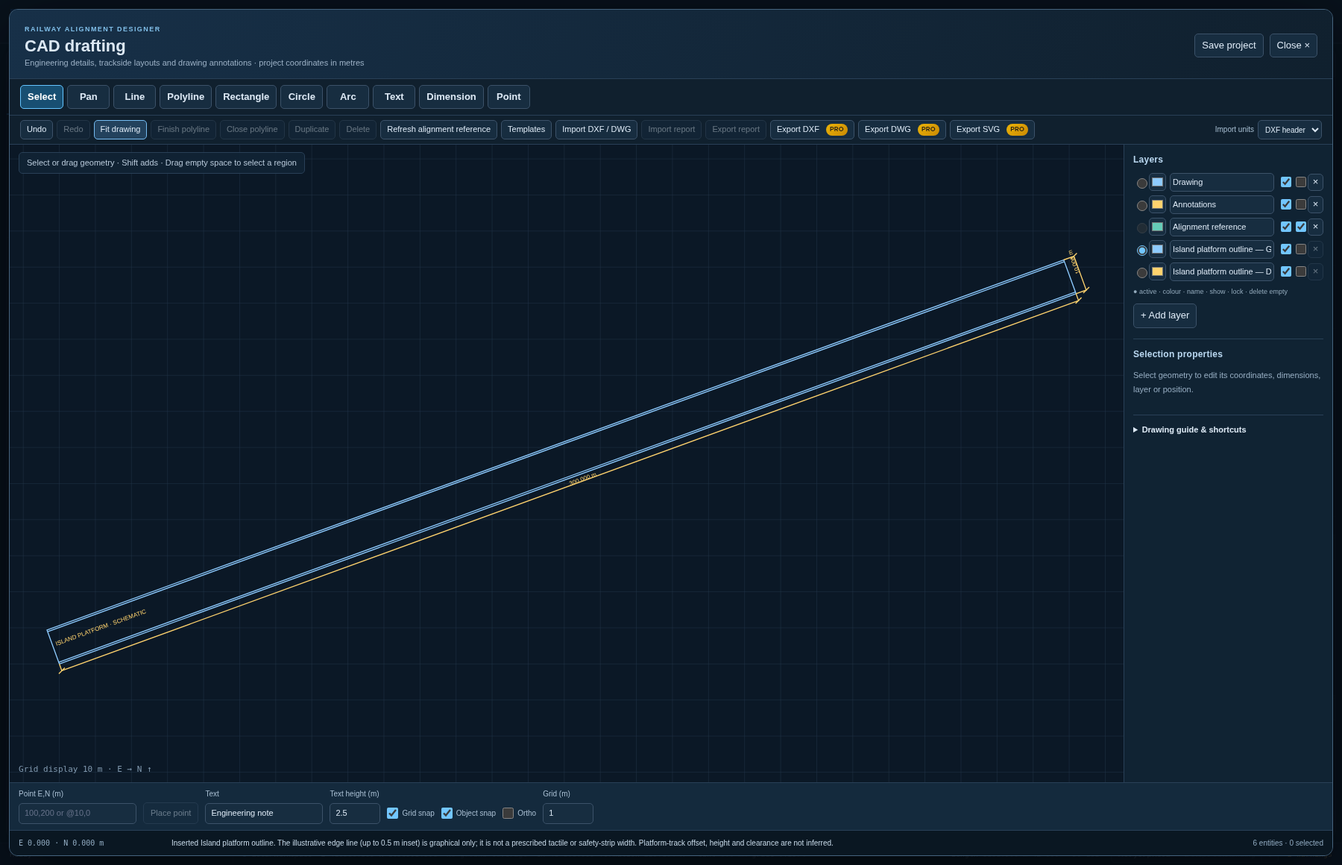
06 / DELIVERABLES
CAD drafting for railway details
01
Choose Alignment → CAD drafting to sketch details in project metres.
02
Use layers, snaps, dimensions and editable drawing properties.
03
Insert reusable components, check exchange reports and save in .rads.
Application demonstration · toolbar positions may differ in earlier captures
Inspect the inserted platform, its layers and the two checked dimensions.
RAD / PRACTICAL TRAINING / 13 October 2026
14 / 23
Notes:
Allow 3 minutes. The actual editor shows a 300 m by 10 m island-platform schematic at 20° rotation. Its dedicated geometry and annotation layers remain editable. CAD supports annotations, layout development and exchange; drawing entities do not change the solved railway alignment or its quantities. Save project retains the drawing. Import DXF / DWG is explained in the next lessons.
Practice: Inspect the inserted platform, its layers and the two checked dimensions.
Reference: https://www.radrailway.com/docs/manual/index.html

Slide 15
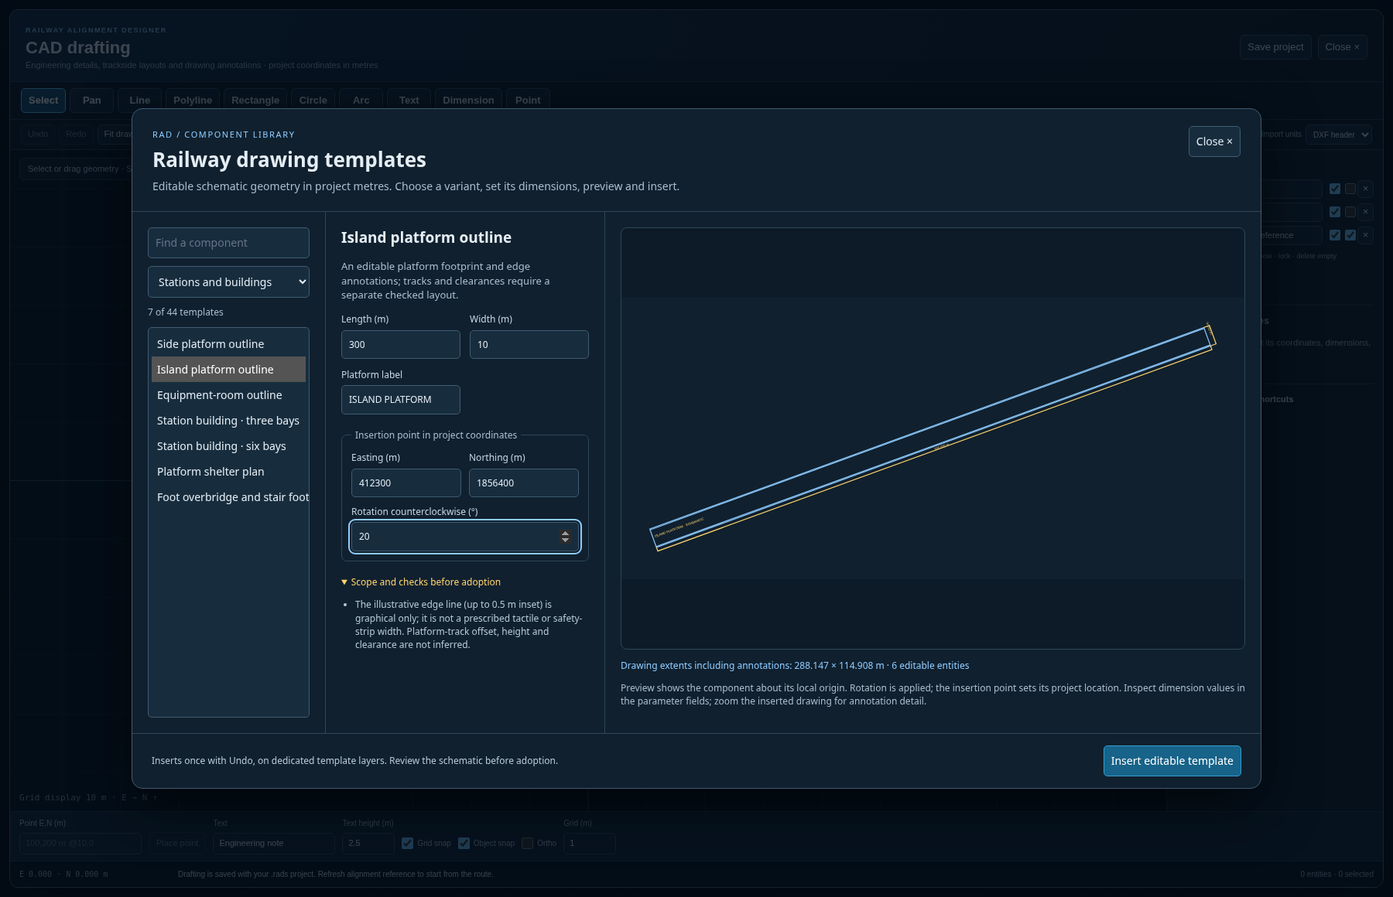
06 / DELIVERABLES
Insert a reusable railway component
01
Open Templates and choose among 44 components in eight families.
02
Edit dimensions, labels, insertion coordinates and rotation.
03
Preview, insert on dedicated layers, then check one Undo and Redo.
Application demonstration · toolbar positions may differ in earlier captures
Insert a 300 × 10 m island platform at 20°, then verify its dimensions.
RAD / PRACTICAL TRAINING / 13 October 2026
15 / 23
Notes:
Allow 3 minutes. Search by component or filter a family. The preview is regenerated from parameter values and extents include annotations. Geometry is in metres; gauge fields use labelled millimetres and paper frames use an explicit 1:N scale. Each insertion is independent editable geometry, not a linked block or live engineered model. Turnouts are schematic rays, clearance envelopes are user studies, and structural outlines are not capacity calculations. Complete the applicable design before adopting a drawing.
Practice: Insert a 300 × 10 m island platform at 20°, then verify its dimensions.
Reference: https://www.radrailway.com/docs/manual/index.html

Slide 16
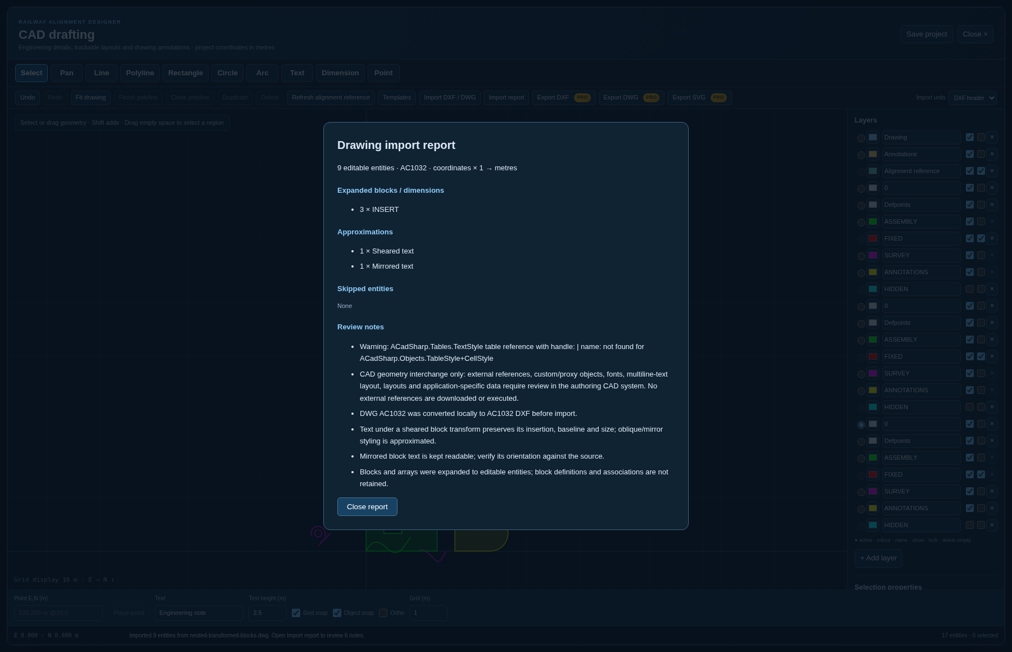
06 / DELIVERABLES
Read the drawing import report
01
Import DXF / DWG with the correct units and coordinate basis.
02
Separate expanded blocks, approximations and skipped entities.
03
Compare the imported geometry and text with the source drawing.
Application demonstration · toolbar positions may differ in earlier captures
Explain why “no skipped entities” is not a guarantee of identical drawings.
RAD / PRACTICAL TRAINING / 13 October 2026
16 / 23
Notes:
Allow 2 minutes. This actual local DWG import expanded three INSERT references and reported sheared and mirrored text approximations. Conversion occurs in the packaged WebAssembly adapter. Supported planar ellipses, splines and hatch loops can remain editable; nested blocks, arrays, dimension graphics and multiline text are flattened. Block and dimension associations are not retained. Three-dimensional solids, meshes, external references and proxy objects are outside the editing model. Conversion warnings and font/layout differences still require review when no entities are skipped.
Practice: Explain why “no skipped entities” is not a guarantee of identical drawings.
Reference: https://www.radrailway.com/docs/manual/index.html

Slide 17
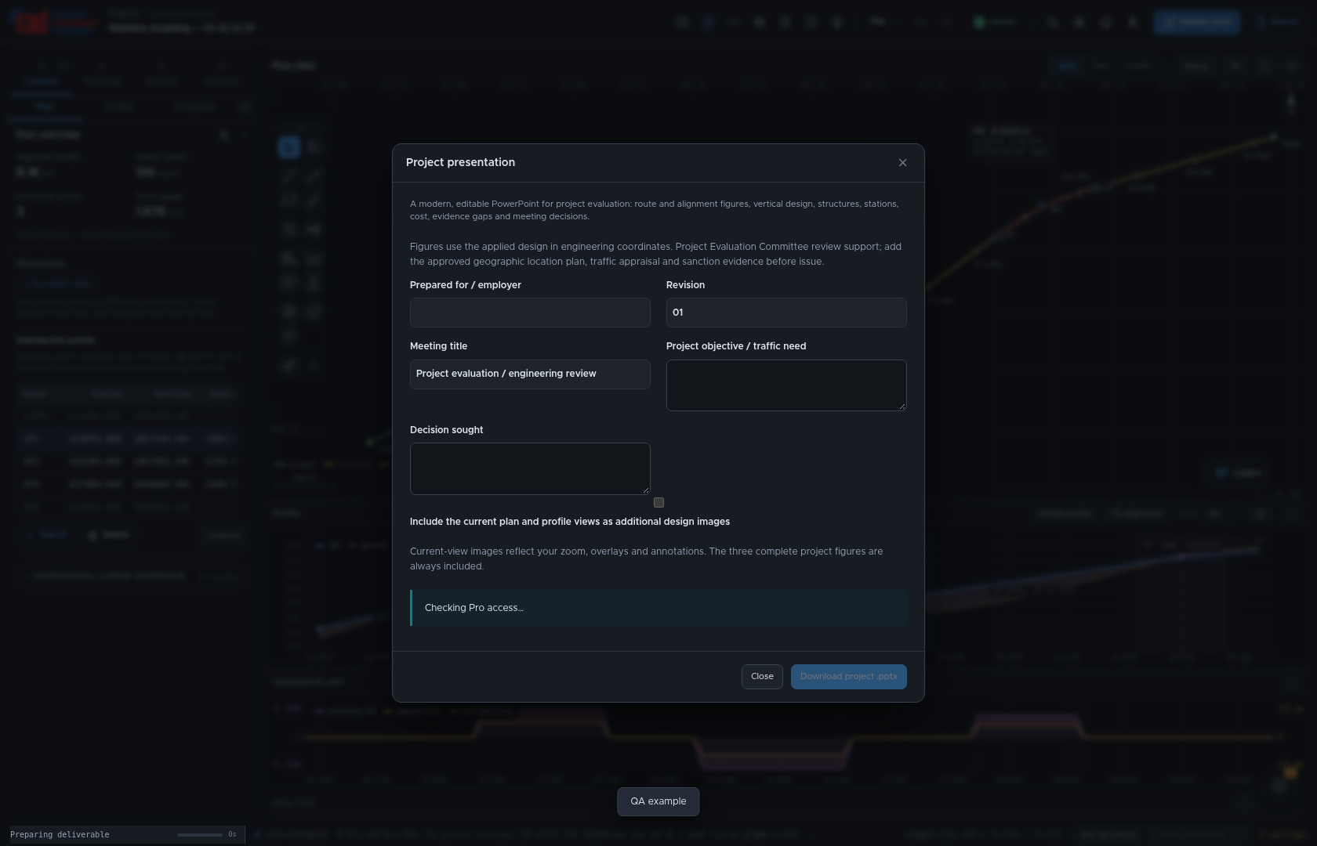
06 / DELIVERABLES
Tell the project story in PowerPoint
01
Choose Export → Project presentation; enter the meeting and decision sought.
02
Review alignment images, profile, design basis, assets and costs.
03
Close with risks, missing inputs, decisions and actions required.
Application demonstration · toolbar positions may differ in earlier captures
Prepare a two-minute recommendation and one explicit decision request.
RAD / PRACTICAL TRAINING / 13 October 2026
17 / 23
Notes:
Allow 3 minutes. The project deck is a technical review starting point, not a claim of a prescribed Indian Railways PEC template or sanction. Confirm every exported figure matches the adopted alternative and cost basis. Add scheme-specific approvals, financing and economics where they are not in the model.
Practice: Prepare a two-minute recommendation and one explicit decision request.
Reference: https://www.radrailway.com/docs/manual/index.html

Slide 18
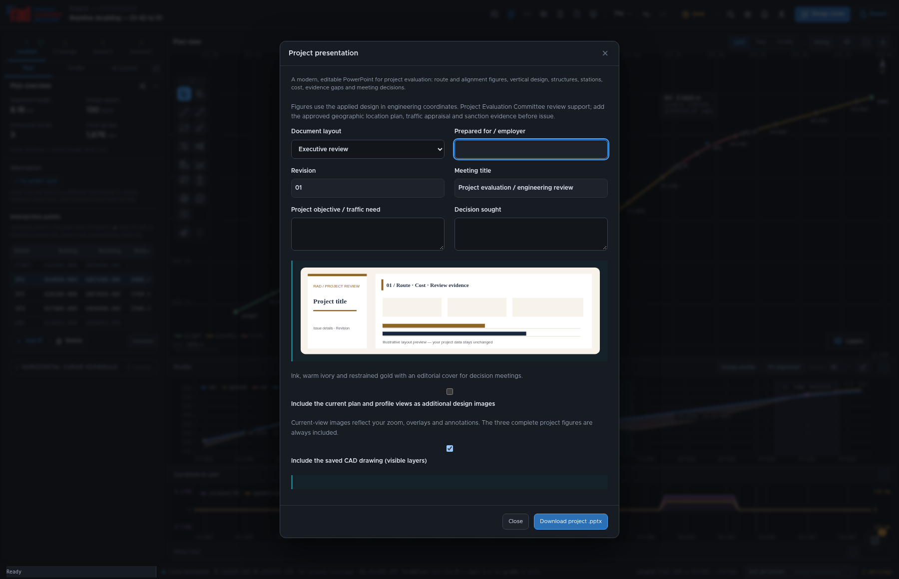
06 / DELIVERABLES
Choose a coordinated document layout
01
Choose Document layout and inspect the six named visual treatments.
02
Use the same family for PPTX, feasibility/DPR, EPC and tender schedules.
03
Check the exported evidence; layout choices do not change the project data.
Application demonstration · toolbar positions may differ in earlier captures
Export two layouts and compare one route quantity and one cost figure.
RAD / PRACTICAL TRAINING / 13 October 2026
18 / 23
Notes:
Allow 2 minutes. Railway corporate, Executive review, Infrastructure delivery, Landscape and sustainability, Technical submission, and Print and tender change the applicable covers, headings, tables and infographic treatment. Feasibility and DPR offer Word or PDF in the publication dialog. EPC is Word; tender schedules are Excel with coordinated typography and palette. The selector retains its choice while that dialog remains open, then defaults to Railway corporate next time. It is not a saved project preference. The miniature preview is illustrative and does not contain the project’s quantities. The exports remain review documents requiring the same evidence and completion regardless of layout.
Practice: Export two layouts and compare one route quantity and one cost figure.
Reference: https://www.radrailway.com/docs/manual/index.html

Slide 19
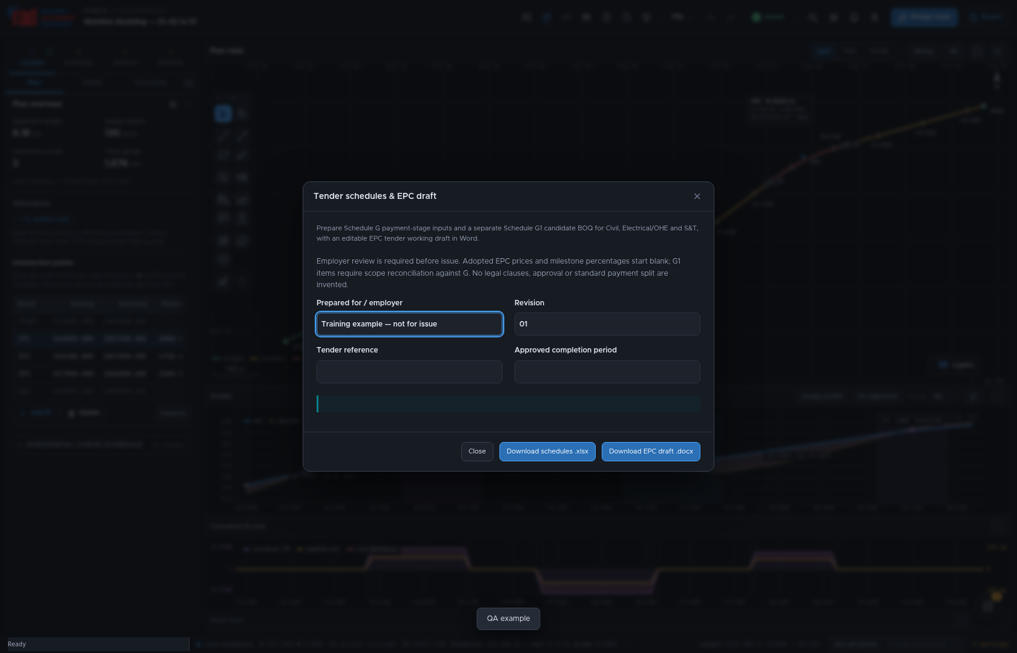
06 / DELIVERABLES
Tender schedules and the EPC draft
01
Choose Export → Tender schedules & EPC draft; complete the project particulars.
02
Review Schedule G stage allocations and G1 itemised work across all three disciplines.
03
Download the EPC Word draft and complete the commercial and legal particulars.
Application demonstration · toolbar positions may differ in earlier captures
List three tender particulars that cannot be inferred from an alignment.
RAD / PRACTICAL TRAINING / 13 October 2026
19 / 23
Notes:
Allow 3 minutes. Examples include employer identity, completion period, securities, eligibility, payment terms and adopted contract conditions. An automatically prepared workbook or Word document is an editable draft. The chosen zonal tender and contract documents govern; verify schedule lettering and prescribed formats for the actual invitation.
Practice: List three tender particulars that cannot be inferred from an alignment.
Reference: https://www.radrailway.com/docs/manual/index.html

Slide 20
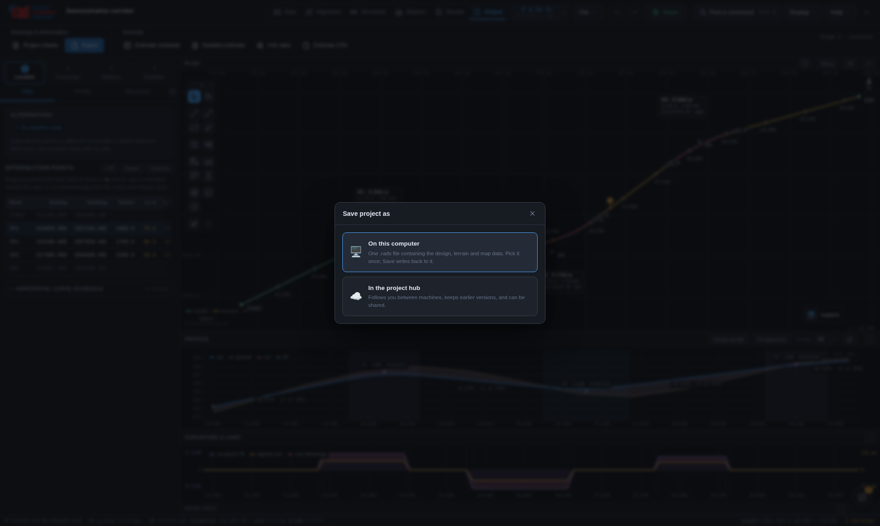
07 / PRACTICE
Save, reopen and exchange
01
Save a named .rads file or choose the intended cloud destination.
02
Reopen it and inspect the adopted alternative, drawing and cost snapshot.
03
Windows installer and Mac app associate .rads with RAD; the portable app does not.
Application demonstration · toolbar positions may differ in earlier captures
Reopen your saved project before handing it to a reviewer.
RAD / PRACTICAL TRAINING / 13 October 2026
20 / 23
Notes:
Allow 2 minutes. Desktop file icons come from the installed operating-system association; a project file cannot force a custom icon on an unconfigured machine. Mac and Windows keyboard shortcuts differ. A file export is distinct from a cloud save. Keep a dated backup before material revisions.
Practice: Reopen your saved project before handing it to a reviewer.
Reference: https://www.radrailway.com/docs/manual/index.html

Slide 21
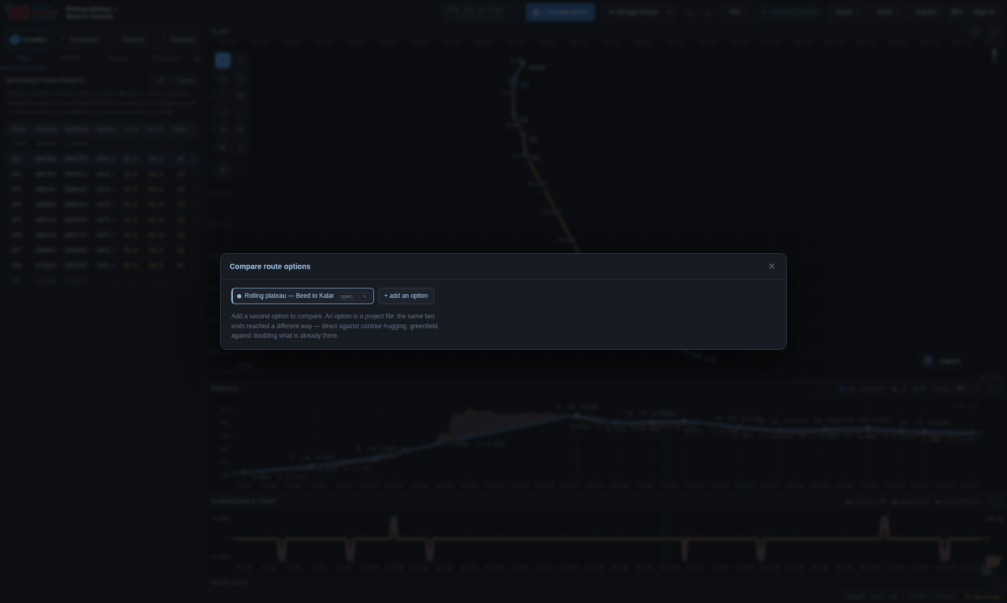
07 / PRACTICE
Guided exercise: a review package
01
Choose a sample, retain two alternatives and describe the preferred route.
02
Resolve or explain a finding; review one bridge and one cost component.
03
Save the project, export the presentation and tender drafts, then reopen.
Application demonstration · toolbar positions may differ in earlier captures
Deliver: .rads + PPTX + schedules XLSX + EPC DOCX + decision note.
RAD / PRACTICAL TRAINING / 13 October 2026
21 / 23
Notes:
Allow 5 to 10 minutes as a separate exercise after the teaching module if required. Use demonstration data and label all outputs training. Assessment: can another engineer trace the route, quantities, assumptions and missing approvals? Review shared outputs before describing them as ready for an employer.
Practice: Deliver: .rads + PPTX + schedules XLSX + EPC DOCX + decision note.
Reference: https://www.radrailway.com/docs/manual/index.html

Slide 22
08 / CHECK
Knowledge check
01
02
03
Does a clear compliance report certify an approved scheme?
Will a saved detailed bill always change after alignment edits?
Can an EPC draft determine the employer’s missing contract conditions?
Answer all three, and explain what review remains necessary.
RAD / PRACTICAL TRAINING / 13 October 2026
22 / 23
Notes:
Allow 2 minutes. Answers: no, no, no. A compliance report applies the configured rules and cannot replace scheme approval. A saved bill may be a fixed snapshot and needs deliberate revision. Employer and tender-specific conditions require authorised completion and review. Discuss a useful next check for each case.
Practice: Answer all three, and explain what review remains necessary.
Reference: https://www.radrailway.com/docs/manual/index.html

Slide 23
08 / CHECK
A practical handover checklist
01
Project basis and coordinates confirmed; adopted route clearly named.
02
Findings, missing inputs, quantity sources and approval owners visible.
03
Saved file reopens; exported figures, costs and scope match the review.
Application demonstration · toolbar positions may differ in earlier captures
Continue: the live manual has figures, notations and Print / save as PDF.
RAD / PRACTICAL TRAINING / 13 October 2026
23 / 23
Notes:
Allow 1 minute. The manual page is the maintained source. PDF is generated from that page at print time; retain the edition and date with a review package. Use the trainer notes and exercise as a repeatable onboarding session. Ask each learner to name one issue they will verify on their next project.
Practice: Continue: the live manual has figures, notations and Print / save as PDF.
Reference: https://www.radrailway.com/docs/manual/index.html

